Slide 1

ENPM673 - PERCEPTION
REAL-TIME SEMANTIC SEGMENTATION
Sriram Prasad | Gowtham Chintalapati | Bhavana B Rao
Group 12

Slide 2
CONTENT
01
INTRODUCTION
02
OBJECTIVES
03
PROCEDURE
04
RESULTS
05
COMPARISON
06
REAL-TIME IMPLEMENTATION

Slide 3
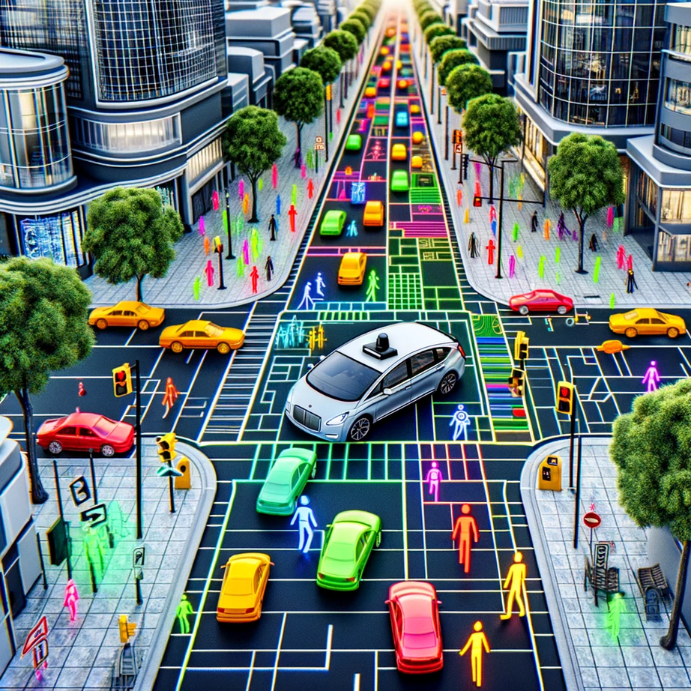



INTRODUCTION
Semantic segmentation: A technique in computer vision to label each pixel of an image with a corresponding class.
Application: Medical Imaging, Autonomous Driving, Satellite Image Analysis

Slide 4

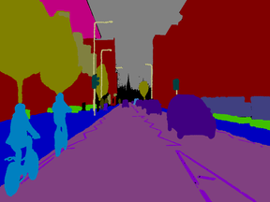
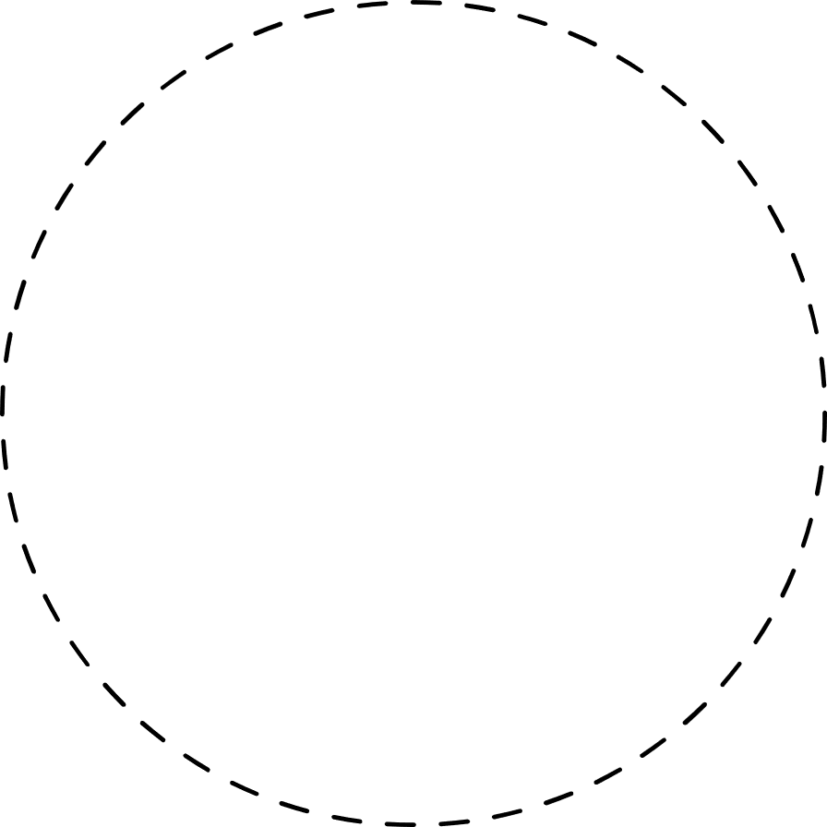
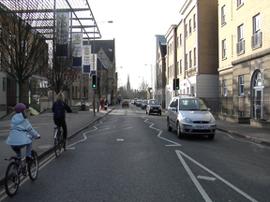
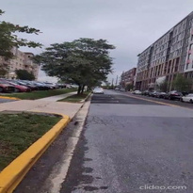
OBJECTIVES
Dataset
Training
Predicted image
Cambridge-driving Labeled Video Dataset.
32 Different classes
Trained on 3 different models
Implemented real-time on a user captured video.

Slide 5
PROCEDURE
Rescaling the image
Map RGB to class indices
Convert RGB labels to 2D maps
Training the model
Prediction and Visualization
Encoder (Contracting Path)
Decoder (Expansive Path)
Output Layer
Convolutional blocks
Max Pooling Layers
Dropout Layers
Transposed Convolutional blocks
1x1 convolution with softmax activation

Slide 6
RESULTS

Slide 7
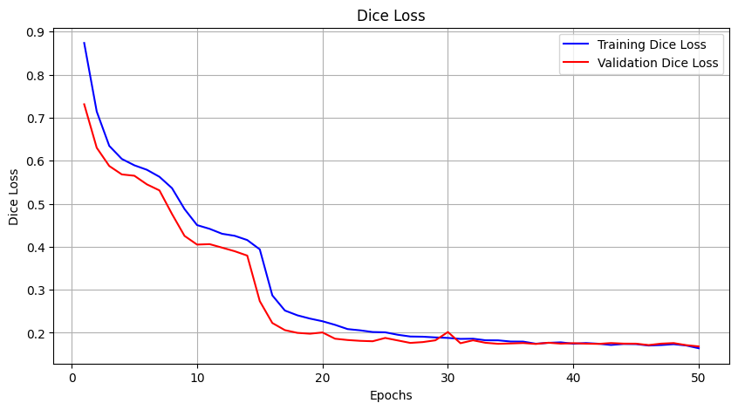
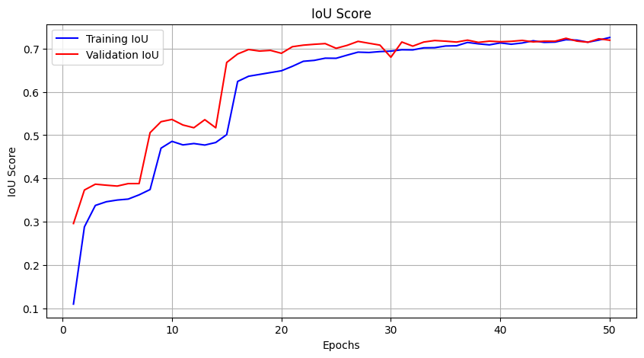
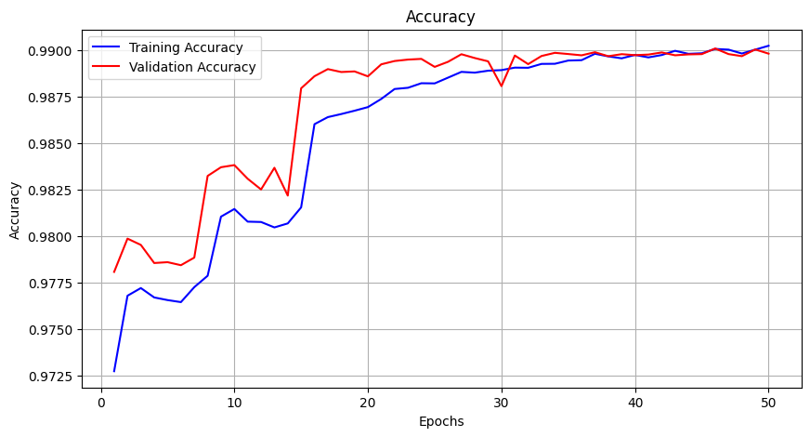
RESNET50 AND UNET

Slide 8
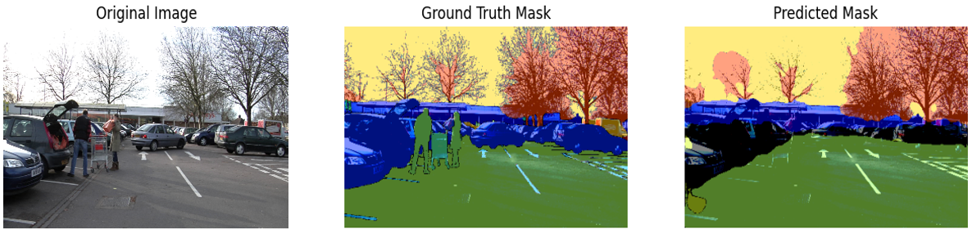
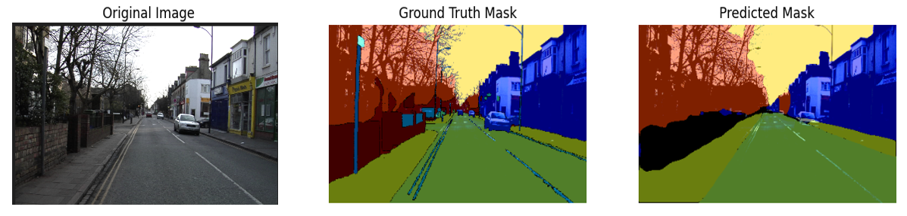
RESNET50 AND UNET

Slide 9
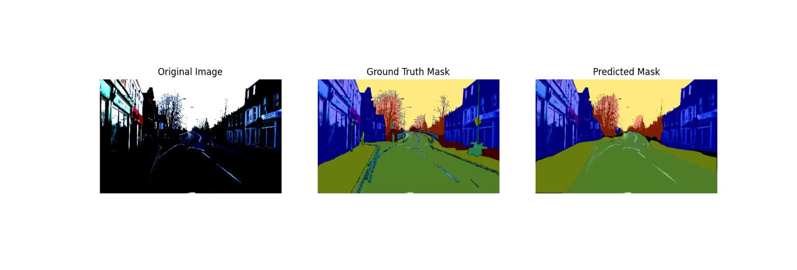
RESNET50 AND UNET

Slide 10
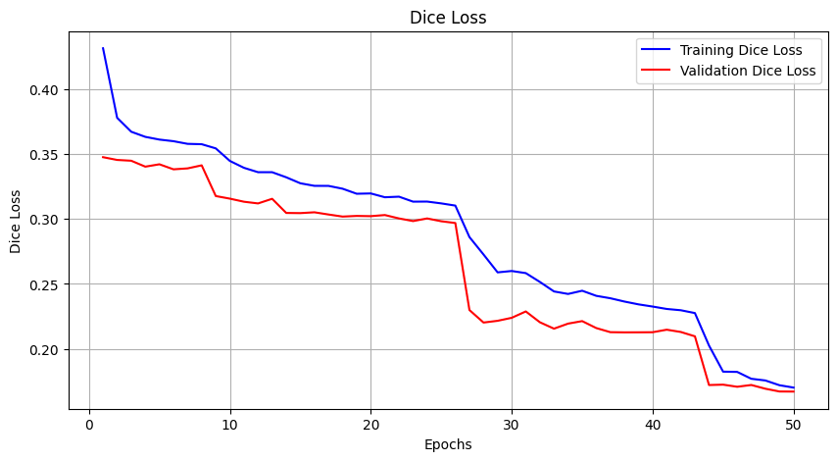
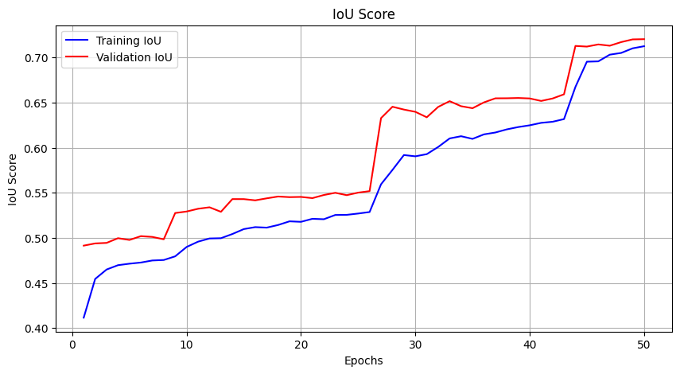
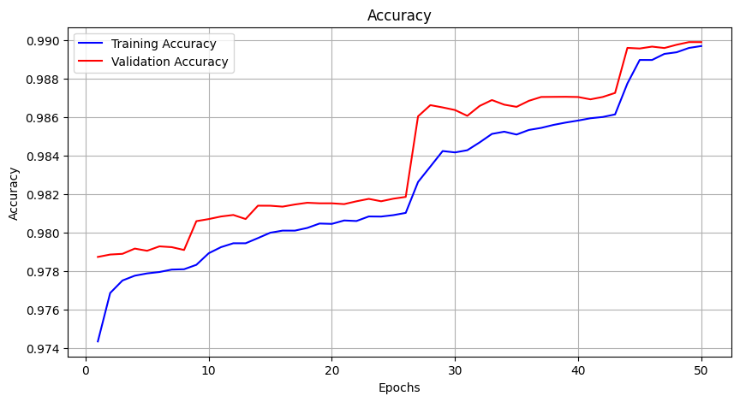
RESNET101 AND FPN

Slide 11
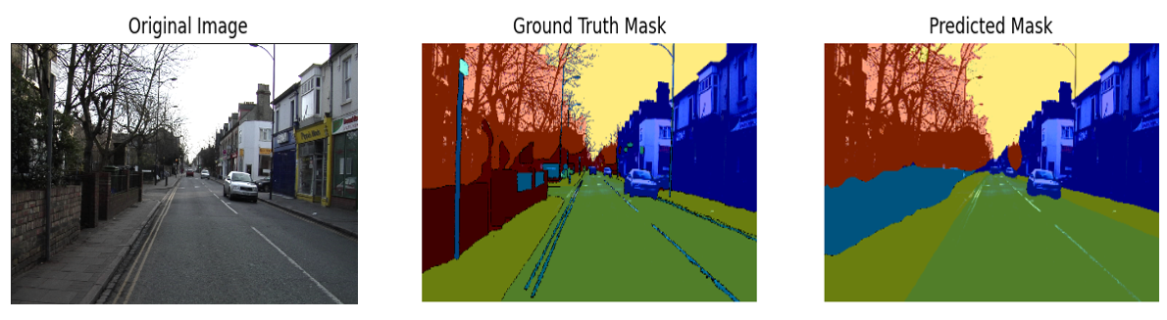
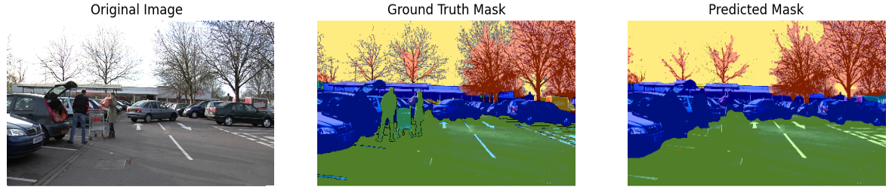
RESNET101 AND FPN

Slide 12
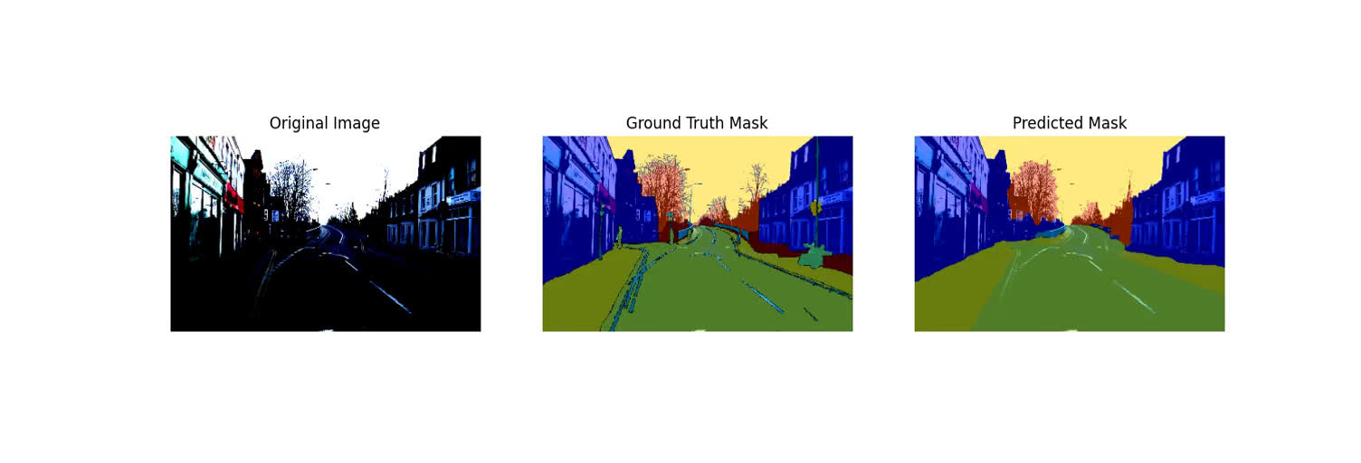
RESNET101 AND FPN

Slide 13
CUSTOM UNET
Encoder (Contracting Path):
Five convolutional blocks, each containing:
Two convolutional layers (Conv)
Batch normalization (BN)
ReLU activation
Max pooling layer (MP) at the end of each block
Filters: 64, 128, 256, 512, and 1024 (doubling at each step)
Dropout layers after the fourth and fifth convolutional blocks
Decoder (Expansive Path):
Four deconvolutional blocks, each containing:
Transposed convolutional layer (Deconv)
Concatenation with the corresponding encoder output (skip connections)
Two convolutional layers with batch normalization and ReLU activation
Filters: 1024, 512, 256, and 128 (halving at each step)
Dropout layers in the first two deconvolutional blocks
Output Layer:
1x1 convolutional layer with softmax activation to produce the segmentation map

Slide 14
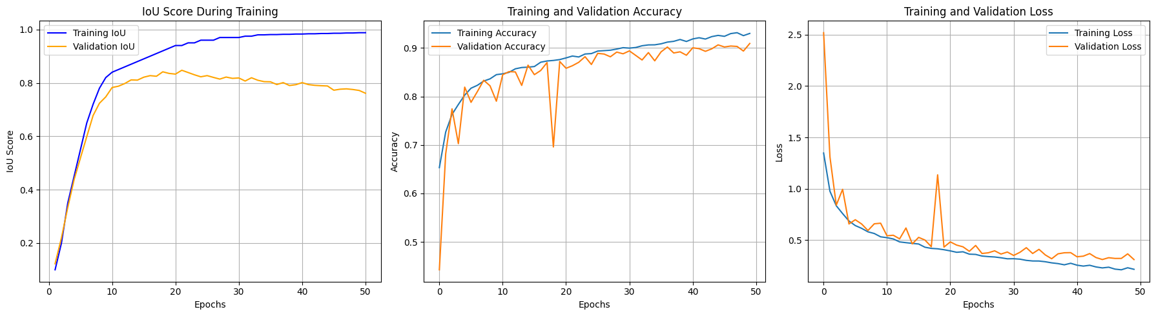
CUSTOM UNET

Slide 15
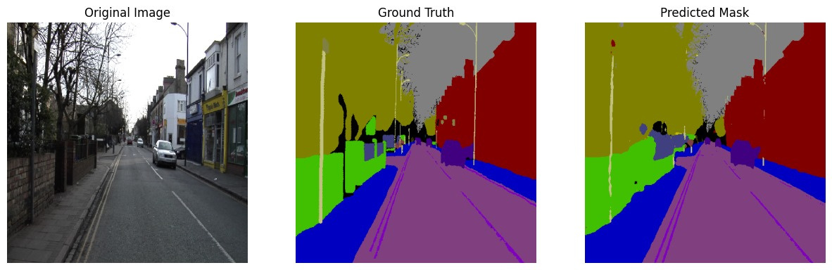
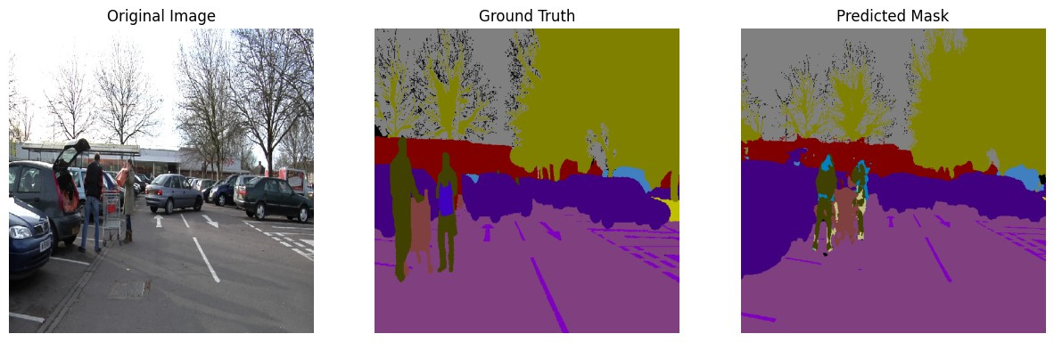
CUSTOM UNET

Slide 16
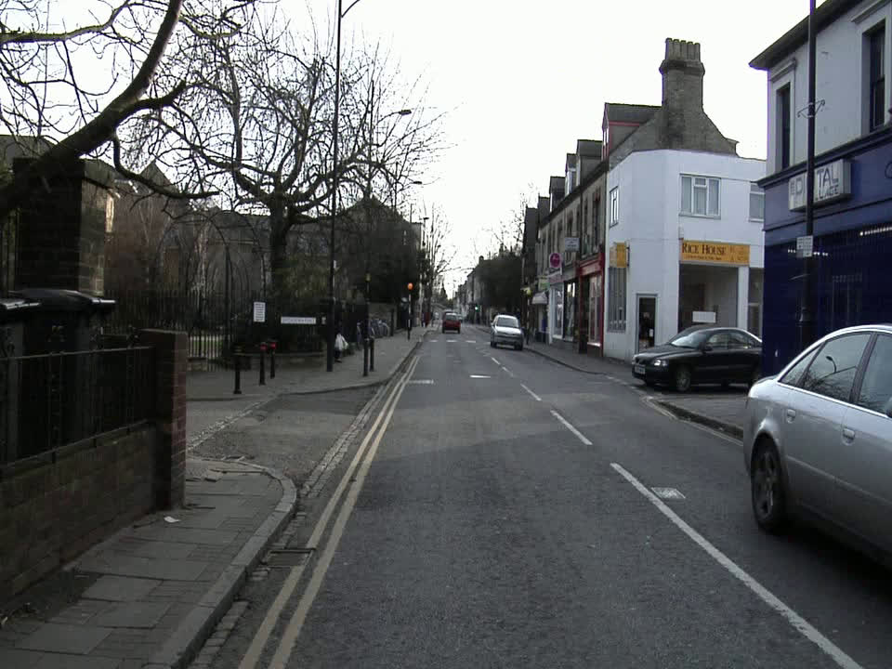
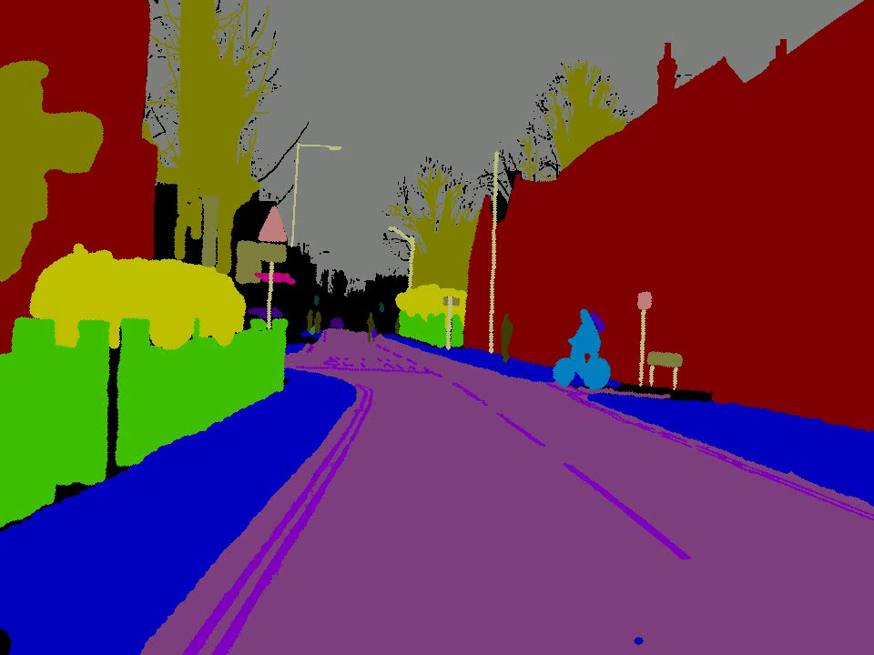
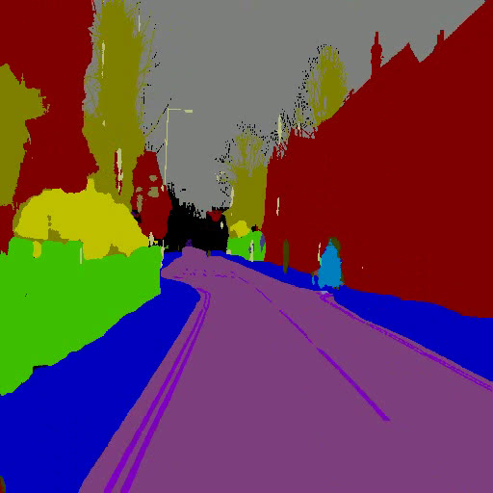
CUSTOM UNET
Original
Ground Truth
Predicted

Slide 17
COMPARISON

Slide 18
Architecture | FPN | UNET | Custom UNET
Feature extractor | RESNET 50 | RESNET50 | CNN
Number of Layers | 101 | 50 | 5 Convolutional blocks
Dropout | Not included | Not included | Included to prevent overfitting
Activation Function | softmax | softmax | RELU
Usage | Typical for object detection | Typical for classification and segmentation | Designed for segmentation

Slide 19
REAL-TIME IMPLEMENTATION

Slide 20
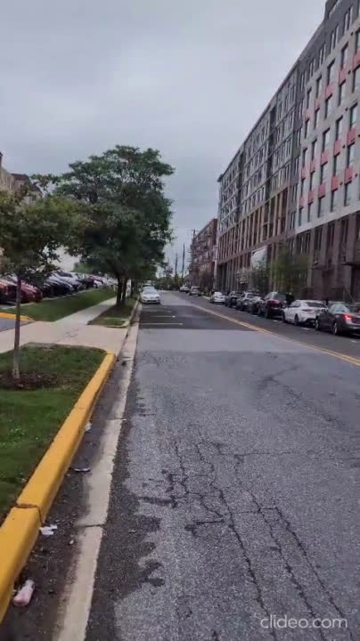
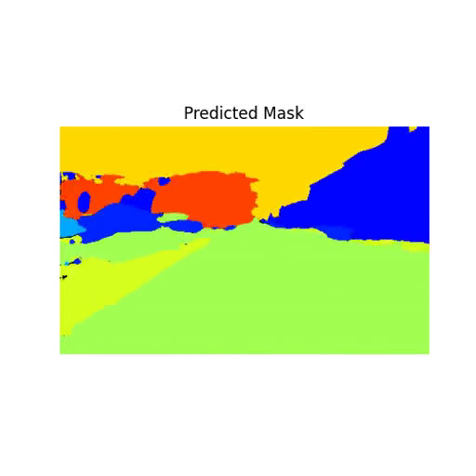
PREDEFINED MODEL

Slide 21
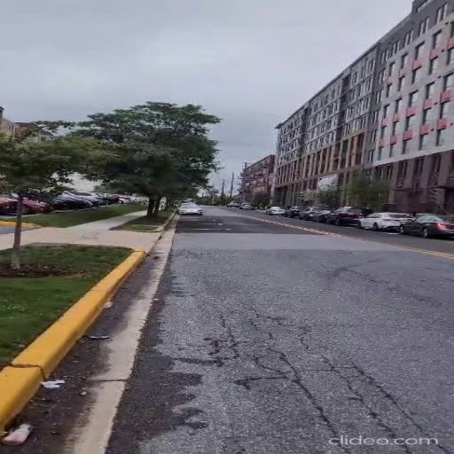
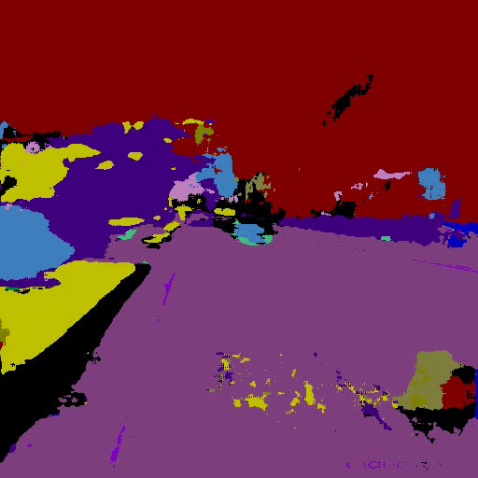
CUSTOM UNET

Slide 22
THANK YOU

